Slide 1

Note: The data and information in this document is reflective of a hypothetical situation and client. This document is to be used for KPMG Virtual Internship purposes only.
Sprocket Central Pty Ltd
Data analytics approach
[Division Name] - [Engagement Manager], [Senior Consultant], [Junior Consultant]

Slide 2
Note: The data and information in this document is reflective of a hypothetical situation and client. This document is to be used for KPMG Virtual Internship purposes only.
Agenda
Introduction
Data Exploration
Model Development
Interpretation

Slide 3
Note: The data and information in this document is reflective of a hypothetical situation and client. This document is to be used for KPMG Virtual Internship purposes only.
Introduction
The Problem:
- To know the customers who are loyal and solution for which customers to be targeted.
The Solution:
- Segmentation of customers into clusters and know underlying trends.
- Each cluster represent different type of customers.
- Recommending the type of customers who are beneficial and generates high revenue to the organization/company.

Slide 4
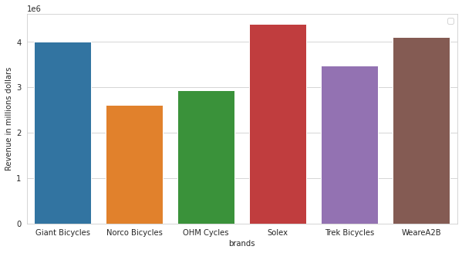
Note: The data and information in this document is reflective of a hypothetical situation and client. This document is to be used for KPMG Virtual Internship purposes only.
Data Exploration
Sales trend for a particular brand
- Solex is the most appreciated brand among the customers.
- WeareA2B and the Giant Bicycles are the second and third most respectively.
Place any supporting images, graphs, data or extra text here.

Slide 5
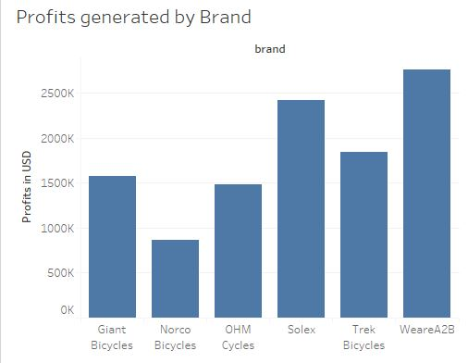
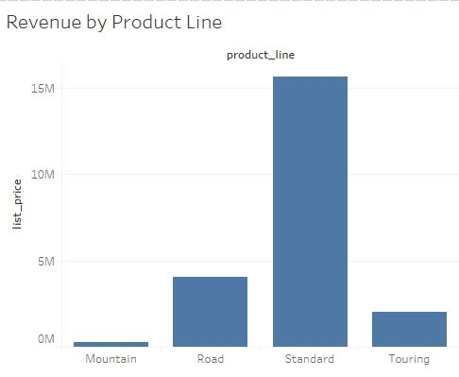
Note: The data and information in this document is reflective of a hypothetical situation and client. This document is to be used for KPMG Virtual Internship purposes only.
Data Exploration
Sales trend for a particular brand
Though Solex has high sales, WeareA2B has generated the highest profits.
- Standard product line has the highest generated revenue.

Slide 6
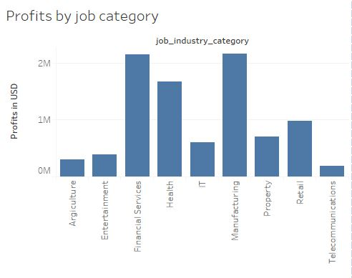
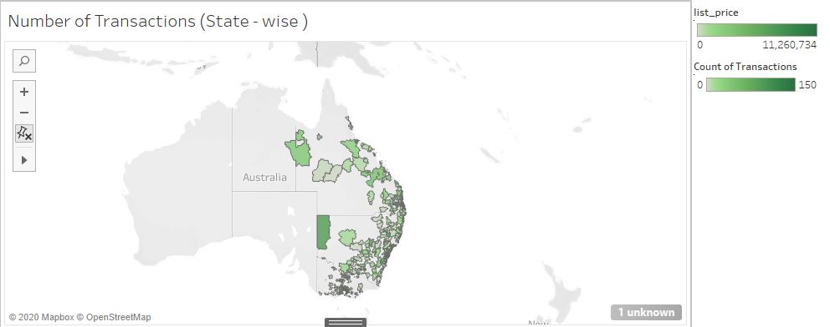
Note: The data and information in this document is reflective of a hypothetical situation and client. This document is to be used for KPMG Virtual Internship purposes only.
Data Exploration
Sales trend for a particular brand
- Manufacturing and Financial Services are the job categories which generate highest profits.
The Map shows the highest number of transactions in a pincode.

Slide 7
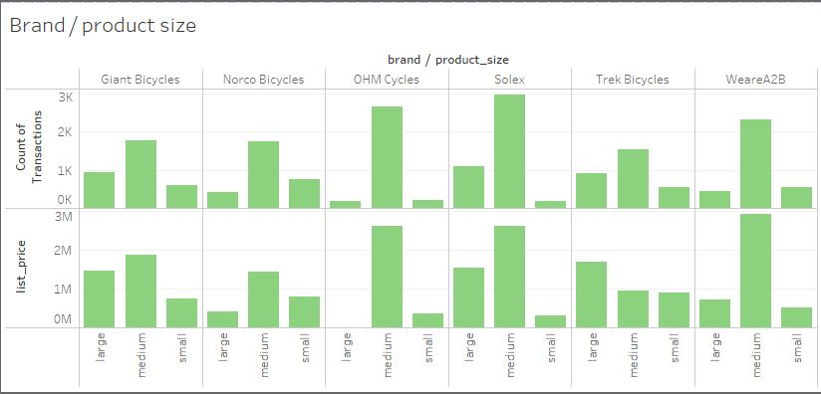
Note: The data and information in this document is reflective of a hypothetical situation and client. This document is to be used for KPMG Virtual Internship purposes only.
Data Exploration
Sales trend for a particular brand
As transactions and revenue are correlated we can see Solex ( medium ) is highly popular.

Slide 8
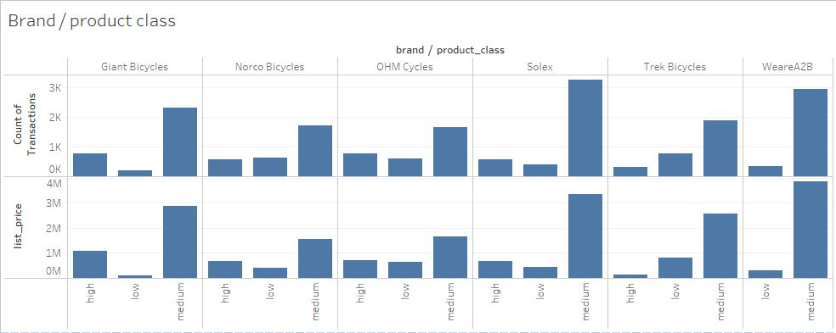
Note: The data and information in this document is reflective of a hypothetical situation and client. This document is to be used for KPMG Virtual Internship purposes only.
Data Exploration
Sales trend for a particular brand
The Solex medium and WeareA2B medium are the highly popular in product class

Slide 9
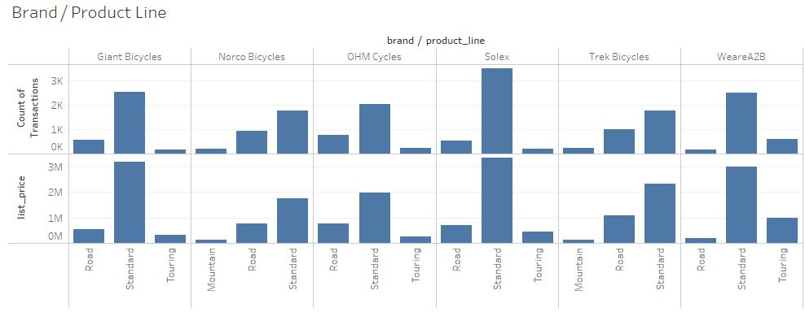
Note: The data and information in this document is reflective of a hypothetical situation and client. This document is to be used for KPMG Virtual Internship purposes only.
Data Exploration
Sales trend for a particular brand
The Solex standard is the highly popular in product line

Slide 10
Note: The data and information in this document is reflective of a hypothetical situation and client. This document is to be used for KPMG Virtual Internship purposes only.
Data Exploration
Sales trend for a particular brand
Highest transactions were done on 2017-02-14 on the occasion of Valentine’s day and on 2017-08-18.
- Giant Bicycles has highest sales in the months of May, August, December. This pattern is observed to be as high sales occur in end of seasons.
(August - Winter end)
(December - Spring end)
(May - autumn end)
Norco Bicycles has highest sales in months April, October, December.
OHM Cycles has highest sales in the month JULY and AUGUST
Solex have highest sales in October and November.
Most purchases are being happened in mid 10 days of the month

Slide 11
Note: The data and information in this document is reflective of a hypothetical situation and client. This document is to be used for KPMG Virtual Internship purposes only.
Data Exploration
Sales trend for a particular brand
- less number of online orders are recorded on 31st of every month
and
- highest online orders are on 15th (15 day pay check)
- Solex has been most preferred by all the age groups.
- Most Valuable and successful are the years 2003-2007 and also have generated most highest revenue for Sprocket central
- The middle aged people are the highest buyers of cycles than any other age group.
- Sprocket central has most of middle aged customers (30-40)
- The middle aged people are more inclined towards standard (product_line)
- NSW state has the highest sales for cycles.

Slide 12
Note: The data and information in this document is reflective of a hypothetical situation and client. This document is to be used for KPMG Virtual Internship purposes only.
Data Exploration
Sales trend for a particular brand
- Queensland has the highest mean for list price
- NSW has generated highest revenue of 11 million dollars
- There are most of property valuation 8 customers shop at sprocket central.
- Property valuation 2 customers buy items worth high money compared to others.
- High concentration towards property valuation 8 and 9 customers.
- Female bought more cycles than men on valentines day.

Slide 13
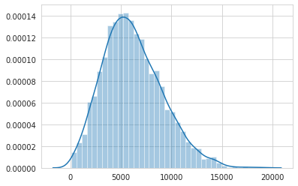
Note: The data and information in this document is reflective of a hypothetical situation and client. This document is to be used for KPMG Virtual Internship purposes only.
Model Development
Distribution Plot for Sum of List Price with customer id
- There are many customers who have transacted the amount between 4000 and 7500 AUD.
- These people are the most to visit and there are less number of customers whose transaction amount is greater than 10000 AUD.
Place any supporting images, graphs, data or extra text here.

Slide 14
Note: The data and information in this document is reflective of a hypothetical situation and client. This document is to be used for KPMG Virtual Internship purposes only.
Model Development
Using K-Means
The data DOB is converted to Age and which has the good chance of accurate model building.
As most of job titles are missing, the job industry category is taken as the main attribute leaving former.
Past 3 year bike related purchases holds a better chance of knowing about the customer.
Wealth segment is one of the key feature to determine the kind of customers (hence it is converted to dummies).
Property valuation helps in determining key characteristics.

Slide 15
Note: The data and information in this document is reflective of a hypothetical situation and client. This document is to be used for KPMG Virtual Internship purposes only.
Model Development
Using K-Means
- Male / Female have different buying trends.
- The states patterns can be determined.
The above attributes are the only attributes which help the model in building accurately.
The Removed Attributes are:
Customer-id
First_name
Last_name
Deceased_indicator

Slide 16
Note: The data and information in this document is reflective of a hypothetical situation and client. This document is to be used for KPMG Virtual Internship purposes only.
Model Development
Using K-Means
Using Elbow method k=3 will be the optimal value to cluster the
customers.
Hence we have used k=3 to segment the customers.
The 3 clusters have been generated for the new customer list.

Slide 17
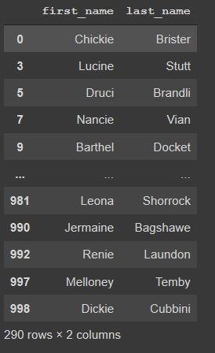
Note: The data and information in this document is reflective of a hypothetical situation and client. This document is to be used for KPMG Virtual Internship purposes only.
Interpretation
The First name and last name of 290 customers are considered to be target group to focus.
Hence this cluster has the high people in marketing, financial
Services and also have higher people in NSW which are the high revenue generators.
The High Property Valuations seems to be high among this cluster among other clusters 1 and 2.
The Tenure is also most likely higher with some exceptions.
- Hence, This cluster is believed to be revenue generating cluster.

